Slide 1
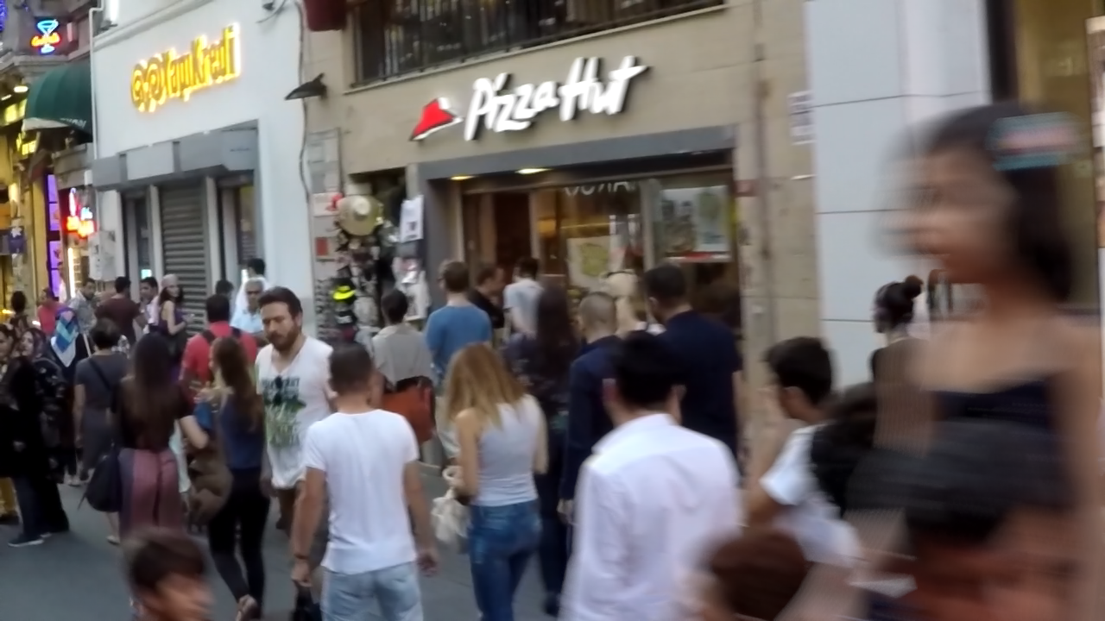
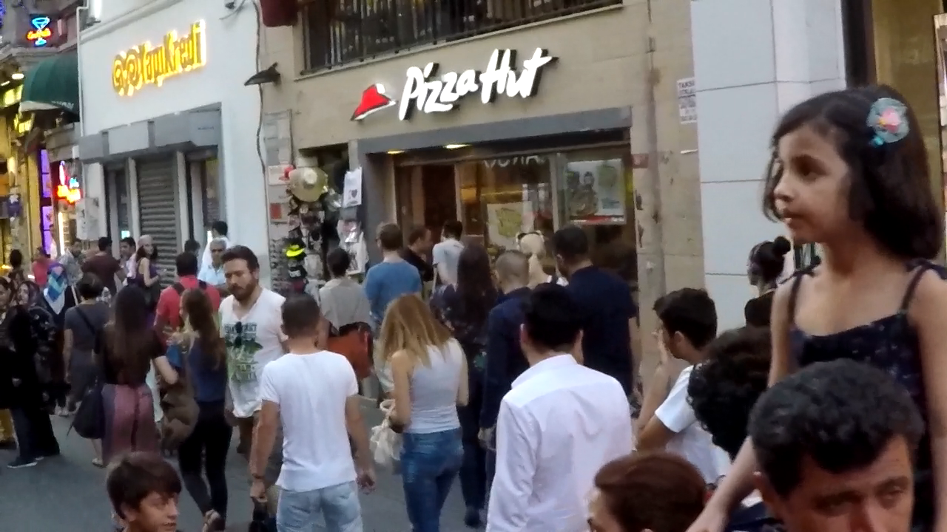
Image Restoration: Reviving Visual Information
Image restoration tackles the challenges of recovering degraded images. Its importance spans archival, forensics, and medical imaging. This field exists at the intersection of computer vision and machine learning.
By Team 1, Under Mentorship,
Mogadampalli Mani Datt (36) Professor P. V. Sudha
Puli Venu (45)
Kspsvln Siddardha Kumar Kavuri (58)

Slide 2
Problem Statement
In various fields such as historical preservation, medical imaging, forensic analysis, and consumer photography, images often suffer from degradation due to factors like noise, blur, low resolution, and environmental damage. Traditional image restoration methods struggle to recover fine details and often fail in extreme cases of degradation.
The challenge is to develop an AI-based image restoration model capable of:
Removing noise, blur, and artifacts from degraded images.
Restoring lost details in old, damaged, or low-resolution images.
Colorizing and enhancing historical black-and-white images.
Improving real-time image and video quality for surveillance, medical scans, and satellite imagery.
Generating high-resolution images from low-quality inputs while maintaining authenticity.
The ultimate goal is to create a scalable, efficient, and automated image restoration system that can be applied across multiple industries.

Slide 3
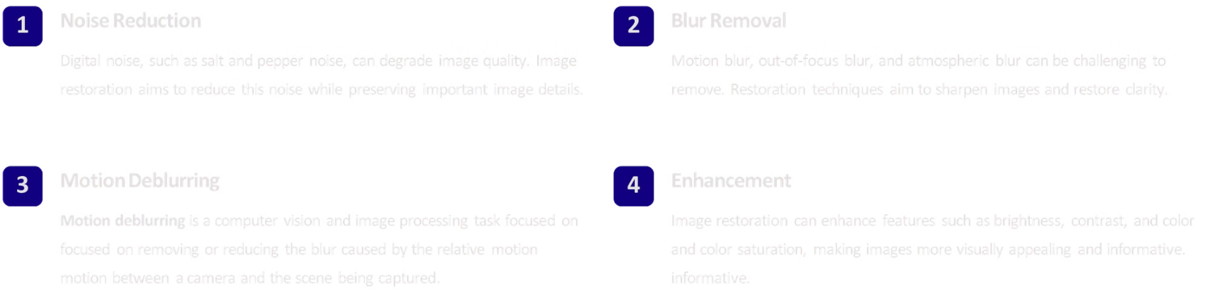
Problem Definition: Understanding the Challenges

Slide 4
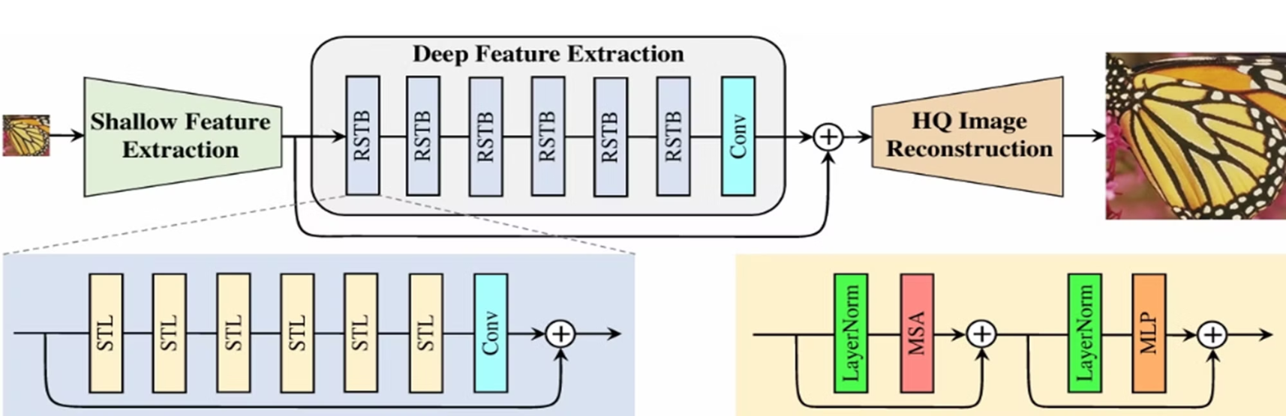
Literature Survey: Existing Techniques and Methodologies
It is a combination of CNN and Transformers which are used to extract the shallow and deep features of the inputimage and produce a high quality image as the output.

Slide 5
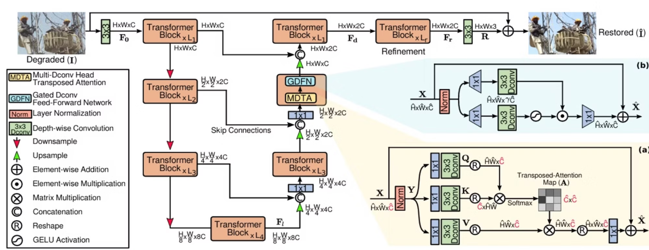
Available Techniques
It is architecture which first encodes or downsamples the image and the decodes or upsamples the image the decrease the effect of noise and retains the features of image. Useful for denoising and deraining data.

Slide 6
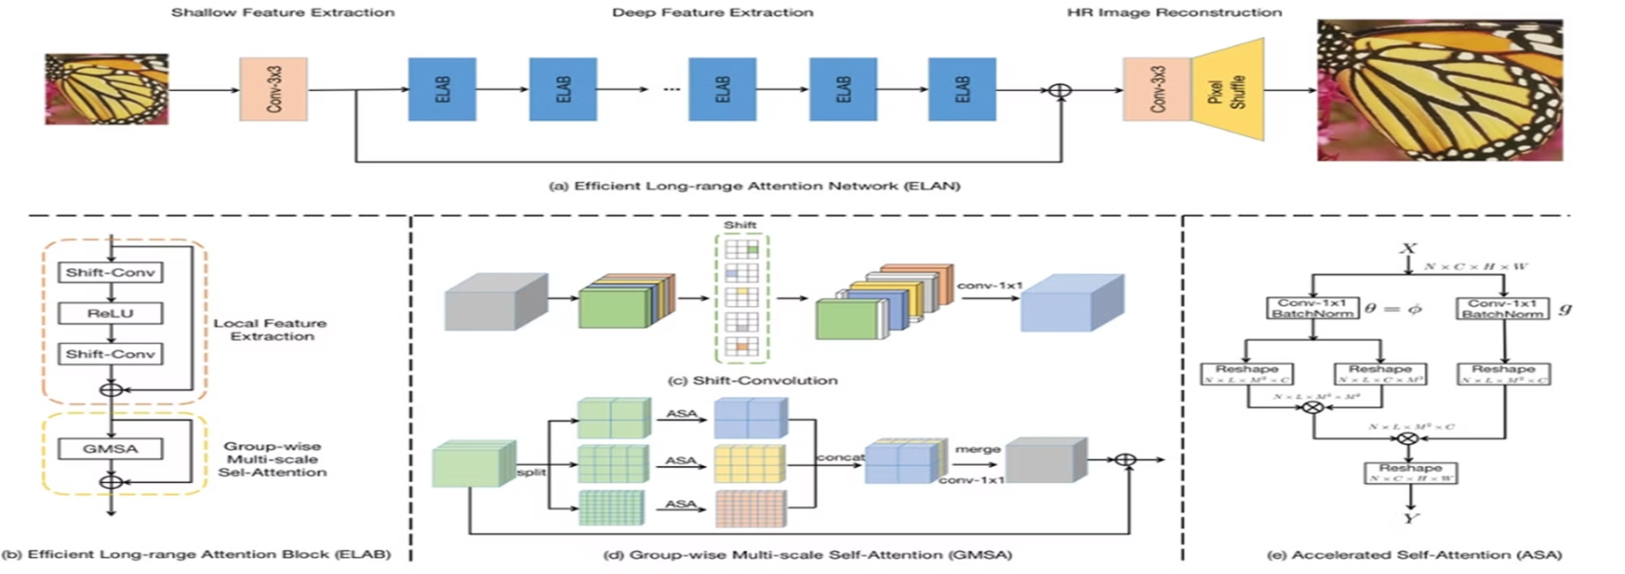
Available Techniques
The ELAN pipeline has three modules: shallow feature extraction, ELAB-based deep feature extraction, and HR image reconstruction. It uses a global shortcut connection, starting with shallow features from a 3×3 convolution, enhancing degraded low-resolution images for reconstruction.

Slide 7
Current Image Restoration Systems
1
Transformers:
long-range operations in image restoration, enhancing feature representation and improving restoration accuracy across tasks.
2
Generative Adversarial Networks (GANs)
GANs have demonstrated exceptional capabilities in generating high-quality restored images.
3
Autoencoders
Autoencoders learn compressed representations of images, allowing for effective restoration of degraded images.

Slide 8




Proposed Restoration Framework
Extraction of Features
Input Blur Images is passed through feature extractor
Encoder and Decoder
After extracting features we need to extract most important features using attention based
Residual blocks
after encoding and decoding the features are thoroughly filtered
Sampling
after going through residual blocks the genrated one is upsampled and downsampled

Slide 9
Technologies Used
Deep Learning Frameworks:
PyTorch: Used for building, training, and deploying deep learning models. Features like torch.nn, torch.optim, DataLoader, and others are pivotal for efficient model development.
Torchvision: Provides image transformation utilities like resizing, tensor conversion, and more for preprocessing.
Image Processing Libraries:
OpenCV (cv2): Used for image saving and format conversion (e.g., RGB to BGR).
Metrics and Data Utilities:
NumPy: Used for numerical computations and handling data arrays.
Learning Rate Optimization:
Warmup Scheduler: For gradually increasing the learning rate during initial epochs, ensuring smoother convergence.
Cosine Annealing Scheduler: Optimizes the learning rate over time for better training stability.
Dataset Management:
Custom Dataset Class: (GOPRO Dataset) specifically tailored for handling the GoPro dataset, including patch-based processing and merging techniques.

Slide 10
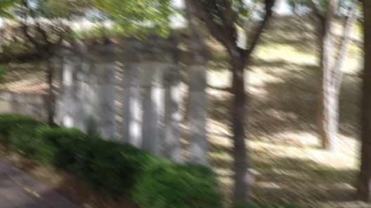
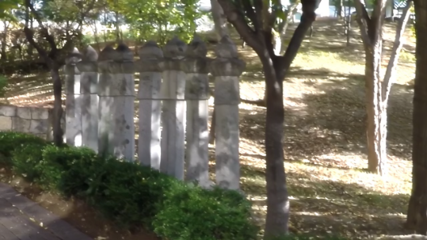

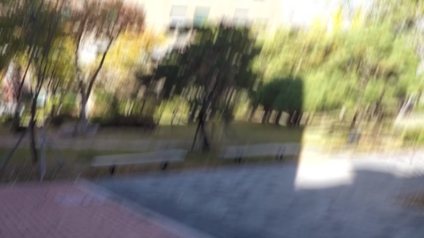

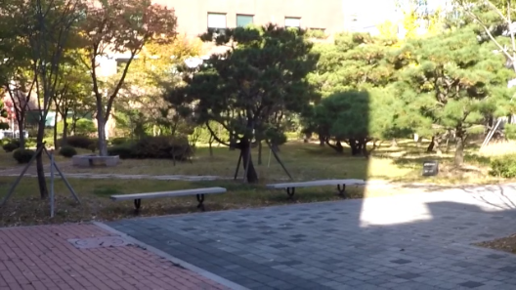
Results
Blur Image
Generated Image
Sharp Image
The images are from GOPRO test dataset (Model is trained on training dataset of gopro)

Slide 11
Evaluation of Model
Performance Metrics:
PSNR (Peak Signal-to-Noise Ratio): 27.6915
SSIM (Structural Similarity Index): 0.9089
Interpretation:
PSNR (27.69 dB):
A higher PSNR indicates better reconstruction quality.
With a value close to 28 dB, the model demonstrates decent denoising or deblurring performance, though there is still room for improvement.
SSIM (0.9089):
SSIM measures the perceptual similarity between the predicted and ground-truth images.
A value of 0.9089 suggests that the model effectively preserves structural details and textures, maintaining high visual fidelity.

Slide 12
Future Scope
Real-Time Restoration in AR/VR Applications Enhancing real-world visuals in Augmented Reality (AR) and Virtual Reality (VR).
Removing noise in real-time video calls and streaming.
Restoration of Artwork & Digital Paintings AI-based reconstruction of damaged paintings and artworks.
Digital restoration for museums and online art galleries.
Space and Astronomy Applications Enhancing low-resolution images from telescopes like Hubble and James Webb.
Noise reduction in astronomical images for better cosmic analysis.
AI in Consumer Photography Mobile cameras using AI for low-light image restoration.
Removing motion blur and noise from smartphone images.
Deepfake Prevention & Ethical Use Advanced AI can distinguish restored images from fake ones, preventing misuse.
Use of AI for image authentication and validation.

Slide 13
References
SwinIR: Image Restoration Using Swin Transformer Jingyun Liang1 Jiezhang Cao1 Guolei Sun1 Kai Zhang1* Luc Van Gool12 Radu Tim
Restormer: Efficient Transformer for High-Resolution Image Restoration Syed Waqas Zamir1 Aditya Arora1 Salman Khan2 Munawar Hayat3 Fahad Shahbaz Khan2 Ming-Hsuan Yang456 1Inception Institute of AI 2Mohamed bin Zayed University of AI 3Monash University 4University of California, Merced 5Yonsei University 6Google Research
Efficient Long-Range Attention Network for Image Super-resolution Xindong Zhang1,2,⋆, Hui Zeng2,⋆, Shi Guo1, and Lei Zhang1,
DiffIR: Efficient Diffusion Model for Image Restoration Bin Xia 1, Yulun Zhang 2, Shiyin Wang 3, Yitong Wang 3, Xinglong Wu 3, Yapeng Tian 4, Wenming Yang 1, and Luc Van Gool 2 1 Tsinghua University, 2 ETH Z¨ urich, 3 ByteDance Inc, 4 University of Texas at Dallas
PromptIR: Prompting for All-in-One Blind Image Restoration Vaishnav Potlapalli⋆, Syed Waqas Zamir†, Salman Khan⋆, Fahad Shahbaz Khan⋆ ⋆Mohamed bin Zayed University of AI, †Inception Institute of AI
InstructIR: High-Quality Image Restoration Following Human Instructions Marcos V. Conde 1,2, Gregor Geigle 1, Radu Timofte 1 1 Computer Vision Lab, CAIDAS & IFI, University of W¨ urzburg 2 Sony PlayStation, FTG

